Slide 1
PARANEOPLASTIC SYNDROMES
Dr. K K Sawlani
Department of Medicine
KGMU
19.08.2014

Slide 2
PARANEOPLASTIC SYNDROMES
Heterogeneous group of disorders
Cause symptoms independent of
Tumor invasion/metastasis
Infection
Ischemia
Metabolic/nutritional deficits
Tumor treatment
Can occur before, during or after the cancer diagnosis

Slide 3
MECHANISM
CANCER CELL
Cytokines
Hormones
Antigen
Specific
symptoms
Remote cell

Slide 4
ASSOCIATED CANCERS
Small cell cancer of the lung
The most common cancer associated with paraneoplastic syndromes
Probably because of its neuroectodermal origin.
Other neoplasms commonly associated
carcinomas of the breast, ovary,
other adenocarcinomas,
lymphoproliferative diseases (especially Hodgkin's disease and thymoma ).

Slide 5
ENDOCRINE PARANEOPLASTIC SYNDROMES
Hormones can be produced from eutopic or ectopic sources
Eutopic
expression of a hormone from its normal tissue of origin, whereas
Ectopic
hormone production from an atypical tissue source.
Ectopic expression leads to
high levels of hormones,
abnormal regulation of hormone production (e.g., defective feedback control)
and peptide processing (resulting in large, unprocessed precursors).

Slide 6
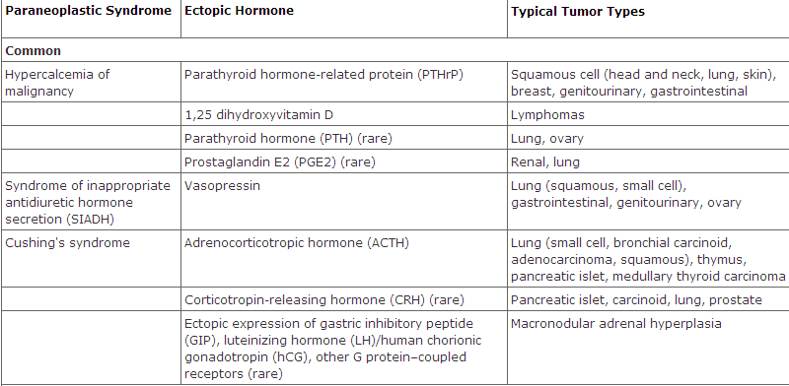
endocrine PARANEOPLASTIC SYNDROMES

Slide 7
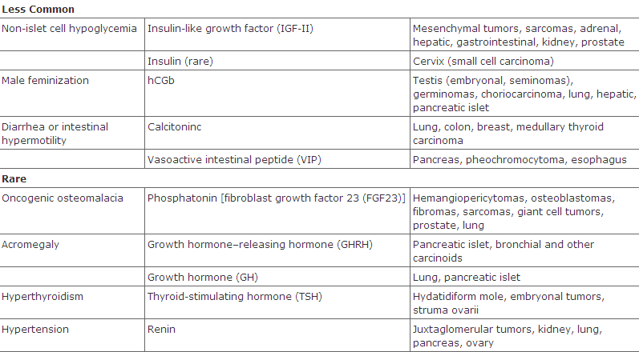
endocrine PARANEOPLASTIC SYNDROMES

Slide 8
Humoral Hypercalcemia of Malignancy ( HHM)
Occurs in up to 20% of patients with cancer
Known malignancy, recent onset of hypercalcemia, very high levels of Ca ⁺⁺
May be initial presenting feature of malignancy
Hypercalciuria, hypophosphatemia, Suppressed PTH levels, metabolic alkalosis .
Increased PTHrP in 80 %, increased 1, 25 (OH) 2 in lymphoma

Slide 9
Cushing’s syndrome caused by ectopic ACTH production
Accounts for 10-20 % of Cushing’s syndrome
SCLC ( >50 %) is the most common cause
Less marked fat gain and centripetal fat redistribution
Fluid retention, hypertension, metabolic alkalosis, glucose intolerance and psychosis.
Incresed pigmentation ( MSH) , marked skin fragility and easy bruising, severe hypokalemia.
High plasma ACTH levels (>100 pg/ml) and do not respond to glucocorticoid suppression

Slide 10
Paraneoplastic Hematologic syndromes
Syndrome | Proteins | Cancers Typically Associated with Syndrome
Erythrocytosis | Erythropoietin | Renal cancers Hepatocarcinoma Cerebellar hemangioblastomas
Granulocytosis (>8000/μL) | G-CSF,GM-CSF,IL-6 | Lung cancer, GI cancer,Ovarian cancer Genitourinary cancer, Hodgkin's disease
Thrombocytosis | IL-6 | Lung cancer Gastrointestinal cancer Breast cancer Ovarian cancer, Lymphoma
Eosinophilia | IL-5 | Lymphoma, Leukemia, Lung cancer
Thrombophlebitis | Unknown | Lung cancer, Pancreatic cancer, GI cancer, Breast cancer Genitourinary cancer Ovarian, Prostate cancer, Lymphoma

Slide 11
Treatment
Erythrocytosis –
Successful resection of the cancer usually resolves the erythrocytosis.
radiation therapy or chemotherapy,
phlebotomy may control any symptoms related to erythrocytosis.
Paraneoplastic granulocytosis does not require treatment. The granulocytosis resolves when the underlying cancer is treated.
Eosinophilia - In most patients who develop shortness of breath related to eosinophilia, symptoms resolve with the use of oral or inhaled glucocorticoids.
Paraneoplastic thrombocytosis does not require treatment.

Slide 12
Thrombophlebitis
Trousseau's syndrome
The coexistence of peripheral venous thrombosis with visceral carcinoma, particularly pancreatic cancer

Slide 13
Thrombophlebitis Treatment
Unfractionated heparin or low-molecular-weight heparin(LMWH) for at least 5 days an
Warfarin started within 1 or 2 days.
Target INR is 2–3.
Continue warfarin for 3–6 months or LMWH for 6 months.
Contraindications to heparin- placement of filter in the inferior vena cava (Greenfield filter) to prevent pulmonary embolism

Slide 14
Prophylaxis
Patients with cancer who undergo a major surgical procedure
heparin prophylaxis or
pneumatic boots
Breast cancer patients undergoing chemotherapy and patients with implanted catheters should be considered for prophylaxis (1 mg/d warfarin).

Slide 15
Paraneoplastic Neurologic Syndromes(PNDs)
In 60% of patients the neurologic symptoms
precede the cancer diagnosis
can occur during or after cancer diagnosis.
Clinically disabling PNDs occur in
0.5–1% of all cancer patients
2–3% of patients with neuroblastoma or small cell lung cancer (SCLC)
30–50% of patients with thymoma.

Slide 16
Paraneoplastic Neurologic Syndromes(PNDs
Most PNDs are mediated by immune responses triggered by neuronal proteins (onconeuronal antigens) expressed by tumors.
In PNDs of the CNS, many antibody-associated immune responses have been identified
These antibodies react with the patient's tumor, and their detection in serum or cerebrospinal fluid (CSF) usually predicts the presence of cancer.

Slide 17
Paraneoplastic Syndromes of the Nervous System
Syndromes of the brain, brainstem, and cerebellum
Focal encephalitis
Cortical encephalitis
Limbic encephalitis
Brainstem encephalitis
Cerebellar dysfunction
Autonomic dysfunction
Paraneoplastic cerebellar degeneration
Opsoclonus-myoclonus
Syndromes of the spinal cord
Subacute necrotizing myelopathy
Motor neuron dysfunction
Myelitis
Stiff-person syndrome
Syndromes of dorsal root ganglia
Sensory neuronopathy
Multiple levels of involvement
Encephalomyelitis, sensory neuronopathy, autonomic dysfunction

Slide 18
Paraneoplastic Syndromes of the Nervous System...
Syndromes of peripheral nerve
Chronic and subacute sensorimotor peripheral neuropathy
Vasculitis of nerve and muscle
Neuropathy associated with malignant monoclonal gammopathies
Peripheral nerve hyperexcitability
Autonomic neuropathy
Syndromes of the neuromuscular junction
Lambert-Eaton myasthenic syndrome
Myasthenia gravis
Syndromes of the muscle
Polymyositis/dermatomyositis
Acute necrotizing myopathy
Syndromes affecting the visual system
Cancer-associated retinopathy (CAR)
Melanoma-associated retinopathy (MAR)
Uveitis (usually in association with encephalomyelitis)

Slide 19
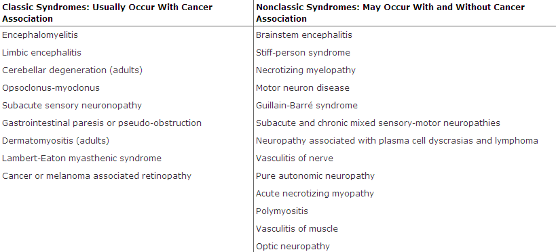
Paraneoplastic Neurologic Syndromes (PNDs)

Slide 20
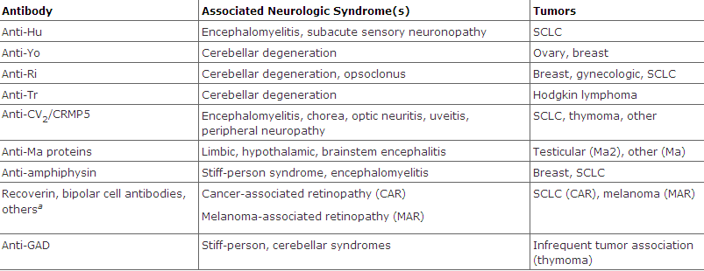
Antibodies to Intracellular Antigens, Syndromes, and Associated Cancers

Slide 21
Antibodies to cell surface or synaptic antigens, syndromes,and associated tumors
Antibody Neurologic Syndrome Tumor Type when Associated
Anti-AChR (muscle)ª Myasthenia gravis Thymoma
Anti-AChR (neuronal)ª Autonomic neuropathy SCLC
Anti-VGKC- related proteins^{b} (LGI1, Caspr2) Neuromyotonia, limbic encephalitis Thymoma, SCLC
Anti-VGCC^{c} LEMS, cerebellar degeneration SCLC
Anti-NMDAR^{d} Anti-NMDAR encephalitis Teratoma
Anti-AMPAR^{d} Limbic encephalitis with relapses SCLC, thymoma, breast
Anti-GABA_{B}R^{d} Limbic encephalitis, seizures SCLC,, neuroendocrine
Glycine receptor^{d} Encephalomyelitis with rigidity, Lung cancer
stiff-person syndrome

Slide 22
Paraneoplastic Encephalomyelitis and Focal Encephalitis Inflammatory involvement of multiple CNS areas including brain, brainstem, cerebellum, and spinal cord
CORTICAL ENCEPHALITIS
may present as "epilepsia partialis continua“
2. LIMBIC ENCEPHALITIS
confusion, depression, agitation, anxiety, severe short-term memory deficits, partial complex seizures, and dementia;
MRI usually shows unilateral or bilateral medial temporal lobe abnormalities.
3. BRAINSTEM ENCEPHALITIS
resulting in eye movement disorders (nystagmus, supranuclear or nuclear paresis),
cranial nerve paresis,
dysarthria, dysphagia.

Slide 23
Paraneoplastic Encephalomyelitis and Focal Encephalitis
4. CEREBELLAR GAIT AND LIMB ATAXIA
MYELITIS
Lower or upper motor neuron symptoms, myoclonus, muscle rigidity, and spasms.
AUTONOMIC DYSFUNCTION as a result of involvement of the neuraxis at multiple levels, including hypothalamus, brainstem, and autonomic nerves.
Cardiac arrhythmias, postural hypotension, or central hypoventilation are frequent causes of death in patients with encephalomyelitis

Slide 24
Paraneoplastic encephalitis
usually associated with SCLC.
Patients with SCLC -anti-Hu antibodies in serum and CSF.
Anti-CV₂/CRMP5 antibodies occur less frequently

Slide 25
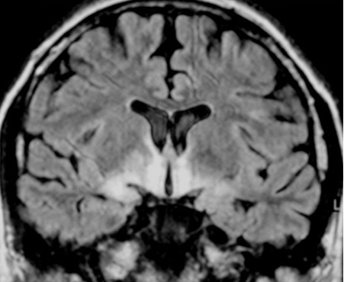
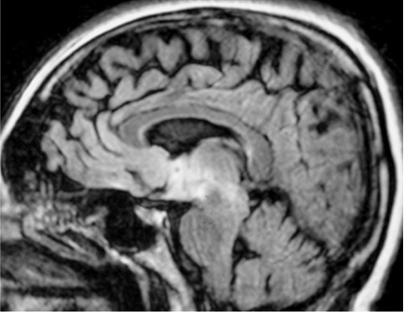
MRI sequences showing abnormal
hyperintensities in the medial
temporal lobes, hypothalamus and
upper brainstem

Slide 26
Treatment
Most types of paraneoplastic encephalitis and encephalomyelitis respond poorly to treatment.
The roles of plasma exchange, IVIg, and immunosuppression have not been established.
Approximately 30% of patients with anti-Ma2-associated encephalitis respond to treatment of the tumor (usually a germ-cell neoplasm of the testis) and immunotherapy.

Slide 27
Paraneoplastic Cerebellar Degeneration
Often preceded by a prodrome that may include dizziness, oscillopsia, blurry or double vision, nausea, and vomiting followed by dysarthria, gait and limb ataxia, and dysphagia.
Early in the course, MRI is usually normal; later, the MRI typically reveals cerebellar atrophy.
Tumors involved
SCLC (Antibodies to P/Q-type VGCC )
cancer of the breast and ovary (Anti-Yo antibodies)
and Hodgkin's lymphoma (anti-Tr antibodies)
Treatment - neurologic improvement after tumor removal, plasma exchange, IVIg, cyclophosphamide, rituximab, or glucocorticoids

Slide 28
LEMS
Presynaptic disorder of the neuromuscular junction leading
Auto-antibody directed against voltage-gated Ca channels →reduced acetylcholine (Ach) release
Common Manifestations
Slowly progressive proximal muscle weakness (legs > arms)
Dry mouth (autonomic dysfunction)
Ptosis/diplopia
Difficulty swallowing/chewing

Slide 29
LEMS
DIFFERENCE FROM MG
LEMS have depressed or absent reflexes,
experience autonomic changes such as dry mouth and impotence
have incremental rather than decremental responses on repetitive nerve stimulation
Most patients with LEMS have an associated malignancy
Most commonly small cell carcinoma of the lung, which may express calcium channels that stimulate the autoimmune response

Slide 30
Treatment of LEMS
Plasmapheresis and immunosuppression
3,4-Diaminopyridine (3,4-DAP) and pyridostigmine may also be symptomatically helpful.
3,4-DAP acts by blocking potassium channels, which results in prolonged depolarization of the motor nerve terminals and thus enhances ACh release
Pyridostigmine prolongs the action of ACh, allowing repeated interactions with AChRs

Slide 31
Paraneoplastic Opsoclonus-Myoclonus Syndrome
Opsoclonus is a
disorder of eye movement characterized by involuntary, chaotic saccades that occur in all directions of gaze;
frequently associated with myoclonus and ataxia.
Associated with
cancer of the lung and breast in adults
neuroblastoma in children.

Slide 32
Paraneoplastic Opsoclonus-Myoclonus Syndrome
If the tumor is not treated, often progresses to encephalopathy, coma, and death.
In addition to treating the tumor, symptoms may respond to immunotherapy (glucocorticoids, plasma exchange, IVIg, ACTH, plasma exchange, and rituximab).

Slide 33
Paraneoplastic Peripheral Neuropathies
Approximately half of patients with sclerotic myeloma develop a
sensorimotor neuropathy with predominantly motor deficits
resembles a chronic inflammatory demyelinating neuropathy
some patients develop elements of the POEMS syndrome (polyneuropathy, organomegaly, endocrinopathy, M protein, skin changes)
Treatment of the plasmacytoma or sclerotic lesions usually improves the neuropathy

Slide 34
Paraneoplastic Peripheral Neuropathies
Vasculitis of the nerve and muscle
causes a painful symmetric or asymmetric distal sensorimotor neuropathy with variable proximal weakness.
It predominantly affects elderly men
associated with an elevated erythrocyte sedimentation rate and increased CSF protein concentration.
SCLC and lymphoma are the primary tumors involved.
Glucocorticoids and cyclophosphamide often result in neurologic improvemet

Slide 35
Peripheral nerve hyperexcitability (neuromyotonia, or Isaacs' syndrome )
spontaneous and continuous muscle fiber activity of peripheral nerve origin.
Clinical features include
cramps,
muscle twitching,
stiffness,
delayed muscle relaxation, and
spontaneous or evoked carpal or pedal spasms.
EMG is diagnostic.
Usually occurs in thymoma and SCLC ( antibodies to VGKC ).
Phenytoin, carbamazepine and plasma exchange may improve symptoms

Slide 36
Paraneoplastic Dermatologic Syndromes
Wide range of skin disorders
The underlying mechanism is usually speculative
Growth factors
Cytokines
Hormones
Can occur before, during or after the cancer
diagnosis

Slide 37
Acnthosis nigricans | Velvety, verrucous, brown hyperpigmentation involving body folds and mucosal membranes | Gastric cancer (also endocrinopathies)
Acquired hypertrichosis lanuginosa (malignant down) | Long, fine, nonpigmented lanugo hairs on face, trunk, limbs, axillae | Carcinomas of the lung, colon, breast, uterus, bladder, and lymphoma
Necrolytic migratory erythema | Circinate erosive erythematous rash, stomatitis | Glucagonoma
Erythema gyratum repens | Concentric rings on trunk and proximal extremities; may have pruritus | Carcinomas of the lung, esophagus, and breast
Sweet's syndrome | Red nodules or plaques, fever, dermal neutrophilic infiltrates | Acute myelogenous leukemia
Pruritus | Excoriations, pruritus occurs on extremities, upper trunk, extensor surfaces | Lymphoma and myeloproliferative disease
Paraneoplastic pemphigus (PNP) | Painful erythematous lesions with blistering; mucous membrane ulcerations | Lymphoma
Acquired ichthyosis | Dry, rough skin with prominent scaling Body, arms, palms and sole | Hodgkin’s disease Non-Hodgkin’s Lymphoma Solid tumors

Slide 38
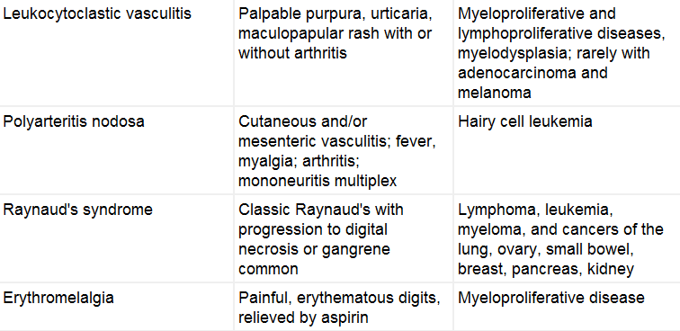
VASCULAR

Slide 39
EVALUATION AND DIAGNOSIS OF PARANEOPLASTIC SYNDROMES
Characterize abnormality; obtain laboratory studies and biopsy as necessary
Carefully elicit any additional symptoms and signs
Eliminate common causes
If there is no obvious etiology, consider a paraneoplastic syndrome
If findings are consistent with a known syndrome, screen for underlying malignancy

Slide 40
EVALUATION AND DIAGNOSIS OF PARANEOPLASTIC SYNDROMES
If signs and symptoms are consistent with a known paraneoplastic syndrome,
undertake a search for an unknown primary cancer
or recurrence or progression of a known primary tumor
Screening should include a
careful physical examination including breast, gynecologic, and prostate evaluations
basic hematology, chemistry, and urine studies
chest radiograph; and mammogram
Computed tomography of the abdomen and pelvis is indicated if there are any suspicious symptoms, signs, or laboratory abnormalities

Slide 41
Thank you

